Slide 1
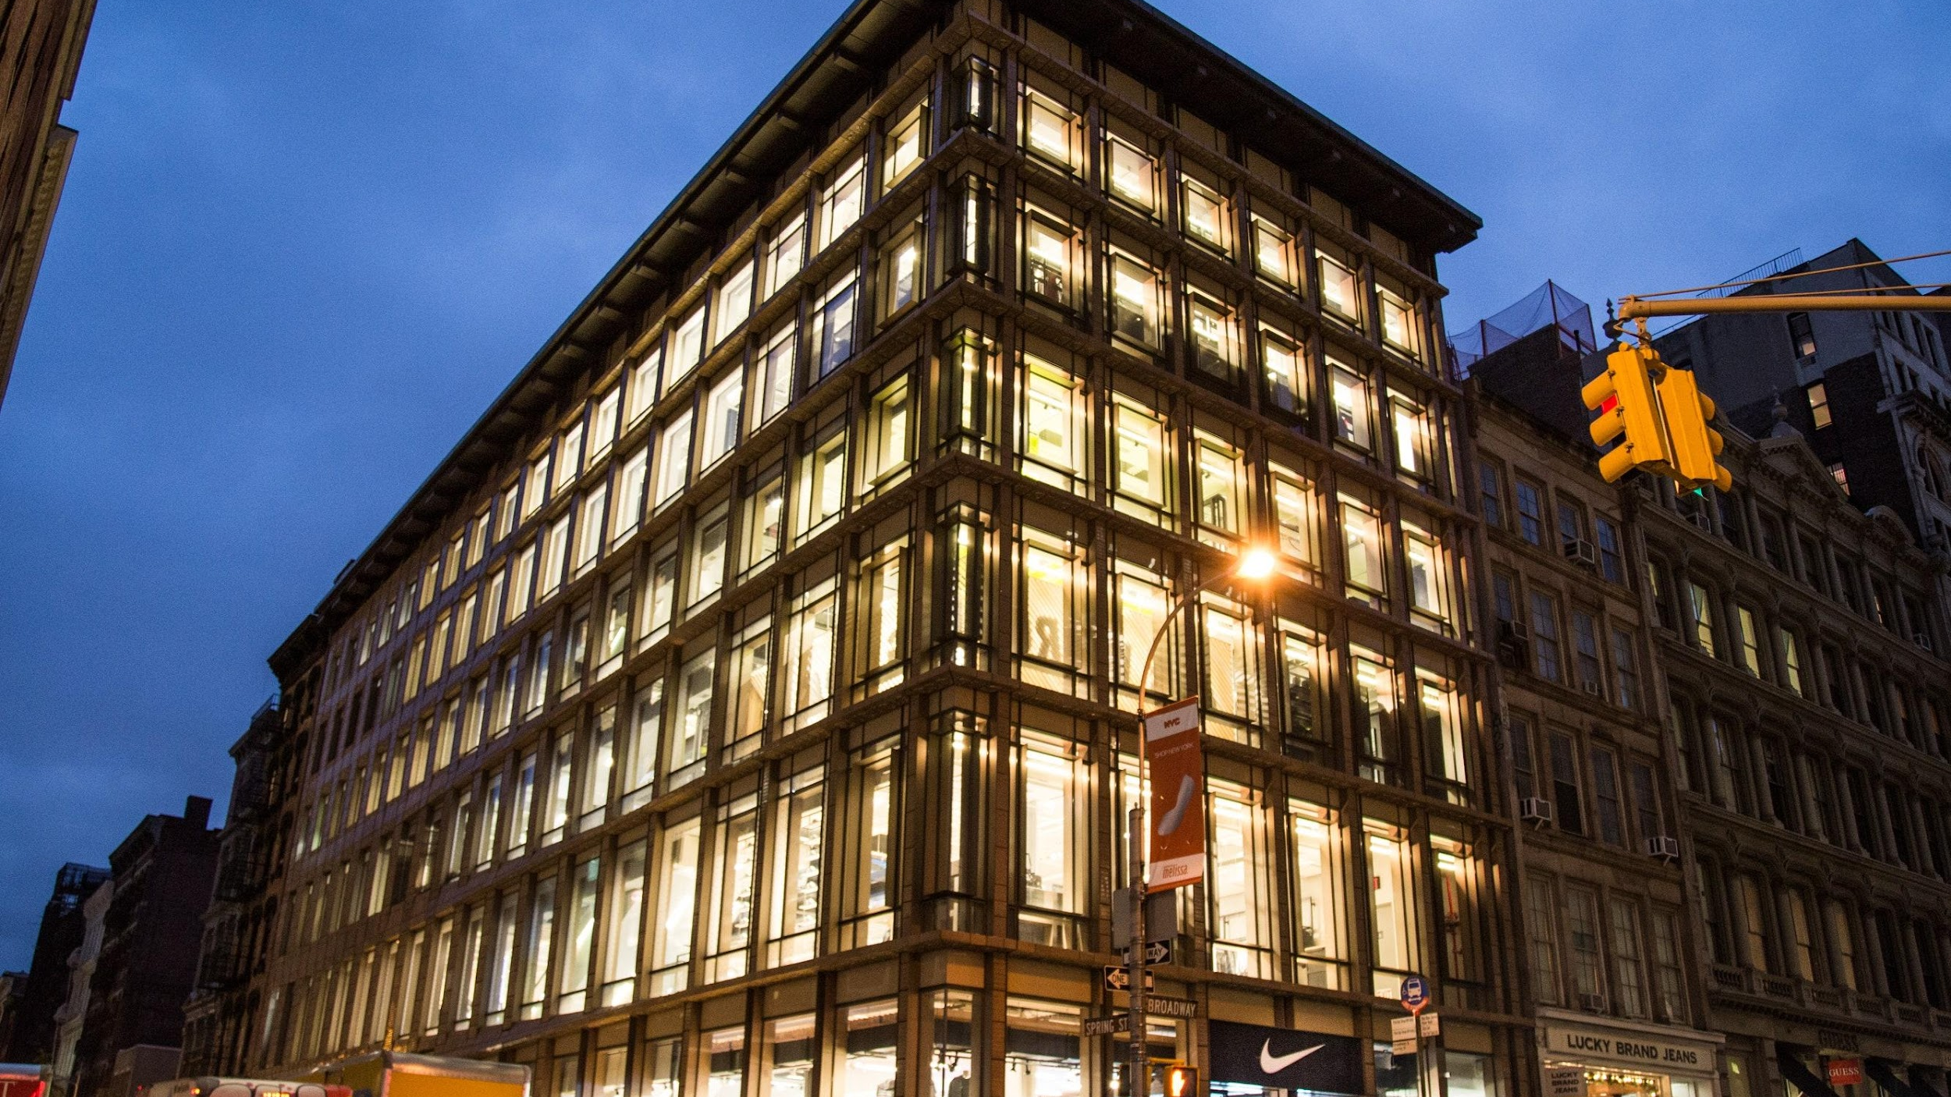
Final Case Study
Corey Satnick, William Goldbaum, Jeffrey Glabman

Slide 2

Who We Are
Senior Portfolio Management Team: We oversee a $25 billion core fund, the largest managed by our firm and have significant influence over the reputation of our firm.
Diverse Investment Experience: Our team has a broad range of experience in various real estate investments, including residential, retail, office, hospitality, and industrial sectors, enabling us to handle a wide array of real estate situations.
Strong Track Record: We have a history of successful investments, with a significant portion of our firm's equity capital allocated to development projects, underscoring our comfort and proficiency in assessing and managing development ventures.

Slide 3


The Opportunity
Joint Venture for Prime Property Redevelopment: This venture offers a chance to collaborate in transforming 529 Broadway, a key commercial asset in the vibrant SoHo district of New York, into a high-value destination for retail.
Strategic Location with Untapped Potential: Situated in a bustling retail hub, the property at 529 Broadway holds immense promise for redevelopment. Leveraging its unused zoning capacity to construct a multi-level building could create an ideal space for flagship stores of renowned brands.

Slide 4
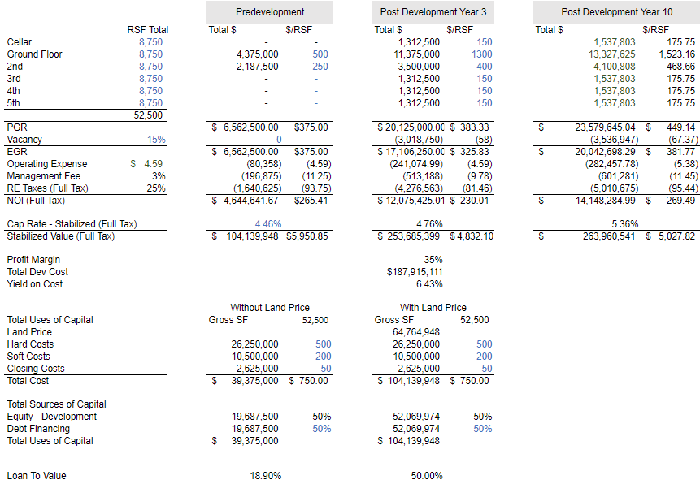
Financials

Slide 5
Comparing Underwriting with Land Costs
 | Without Land Cost | With Land Cost
LTV | 18.9% | 50.0%
Unlevered IRR | 29.5% | 14.7%
Levered IRR | 39.2 % | 20.1%
Unlevered Multiple | 8.8x | 3.3x
Levered Multiple | 15.7x | 5.2x
Unlevered Profit Margin | 88.7% | 70.1%
Levered Profit Margin | 93.6% | 80.3%

Slide 6
Risks and Mitigation
 | Risk | Mitigation
Tenant Acquisition | The uncertainty in securing flagship tenants for the new development, especially given the ambitious plan of having retail on all floors.There are no strong statistics showing vacancy is 15-20%. | Offer competitive lease terms and incentives. We have establish relationships with key leasing brokers using our reputation at the firm.
Firms Reputation | The potential negative impact on the firm’s reputation if the project fails or does not meet expectations | We are ensuring transparent communication throughout the project and will deliver weekly reports based on progress.
Financing Risk | Rising interest rates could increase financing costs. | Locked in fixed-rate financing options at well below the stabilized value of the property. Our LTV is 18.9% making our financing risk minimal.
Misalignment with Sponsor | The sponsor's preference for record-breaking rents and her 50% success rate in this approach could lead to higher vacancy rates and financial underperformance. | We are establishing mutual objectives with the sponsor on the onset of the project.We will continue to look at market feedback for adjusted rents along with flexible lease terms that are adaptable to market conditions
Development and Construction Risk | Delay or cost overruns can impact project timeline | We have reputable contractors that we’ve worked with in the past. We have weekly reports.

Slide 7

Recommendations
Given the financial indicators, the project appears to be a robust investment opportunity, assuming the underlying assumptions such as rent growth, vacancy rates, operating expenses, and exit cap rates hold true.
The biggest benefit in this investment is that we already own the land and the returns are maximized through repurposing the building to utilize unused zoning rights.
The two biggest risk in this investment is the lack of a credit tenant and aligning with the sponsor.

